Slide 1


Martin Byrne
Feb 2022

Slide 2

Outline
Executive Summary
Introduction
Methodology
Results
Conclusion
Appendix

Slide 3

Executive Summary
Summary of methodologies
Data Collection through API
Data Collection for Web Scraping
Data Wrangling
Exploratory Data Analysis with SQL
Exploratory Data Analysis with SQL
Interactive Visual Analytics with Folium and plotly Dash
Machine Learning Prediction
Summary of all results
Exploratory Data Analysis result
Interactive analytics in screenshots
Predictive Analytics result

Slide 4
Introduction
Project background and context
The commercial space age is here, companies are making space travel affordable for everyone. Virgin Galactic is providing suborbital spaceflights. Rocket Lab is a small satellite provider. Blue Origin manufactures sub-orbital and orbital reusable rockets. Perhaps the most successful is SpaceX. SpaceX’s accomplishments include: Sending spacecraft to the International Space Station. Starlink, a satellite internet constellation providing satellite Internet access. Sending manned missions to Space. One reason SpaceX can do this is the rocket launches are relatively inexpensive. SpaceX advertises Falcon 9 rocket launches on its website with a cost of 62 million dollars; other providers cost upwards of 165 million dollars each, much of the savings is because SpaceX can reuse the first stage. Therefore, if we can determine if the first stage will land, we can determine the cost of a launch. This stage is quite large and expensive. Unlike other rocket providers, SpaceX's Falcon 9 Can recover the first stage.
Problems you want to find answers
What influences if the rocket will land successfully?
The effect each relationship with certain rocket variables will impact in determining the success rate of a successful landing
What conditions does Space X have to achieveto get the best results and ensure the best rocket success landing rate

Slide 5

Section 1

Slide 6
Methodology
Executive Summary
Data collection methodology:
Data was collected using SpaceX API and web scraping from Wikipedia
Perform data wrangling
One-hot encoding was applied to categorical features
Perform exploratory data analysis (EDA) using visualization and SQL
Perform interactive visual analytics using Folium and Plotly Dash
Perform predictive analysis using classification models
How to build, tune, evaluate classification models

Slide 7
Data Collection
The datasets were collected by:
SpaceX REST API
This API provides data about launches (e.g. rocket used, payload delivered, launch specifications, landing specifications, landing outcome)
The response content was decoded as a Json using .json() function call and turned into a pandas dataframe using .json_normalize()
Data was cleaned, checked for missing values and missing values inserted where required
SpaceX Webscraping
Webscraping from Wikipedia for Falcon 9 launch records using BeautifulSoup
extract the launch records as HTML table, parse the table and convert it to a pandas dataframe for future analysis
SpaceX REST API
API returns SpaceX data in .json
Normalise data into text file (.csv)
Get HTML Response from Wikipedia
Extract data using BeautifulSoup
Normalise data into text file (.csv)

Slide 8
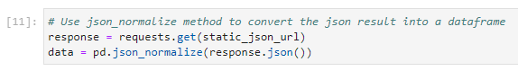
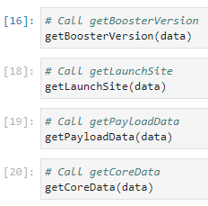
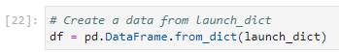
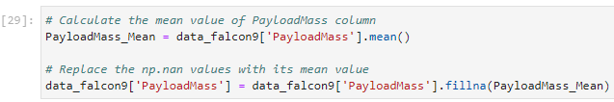
Data Collection – SpaceX API
1. Get Response from API
2. Convert response to .json file
3. Apply custom functions
4. Assign list to dictionary then dataframe
5. Deal with missing values
6. Export to .csv
Link to GitHub: https://github.com/MartinB107/IBM-Data-Science-Project/blob/main/01%20SpaceX_Data_Collection_API.ipynb

Slide 9
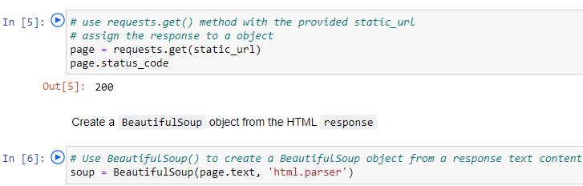
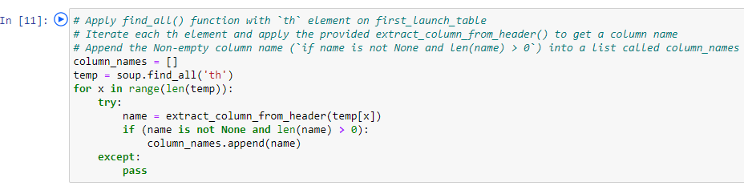
Data Collection - Scraping
Get Response from HTML
Create BeautifulSoup object
Find tables
Get Column names
Create a data frame by parsing the launch HTML tables
Extract to .csv file
Link to GitHub: https://github.com/MartinB107/IBM-Data-Science-Project/blob/main/01%20SpaceX_Data_Collection_API.ipynb

Slide 10
Data Wrangling
In the data set, there are several different cases where the booster did not land successfully. Sometimes a landing was attempted but failed due to an accident; for example, True Ocean means the mission outcome was successfully landed to a specific region of the ocean while False Ocean means the mission outcome was unsuccessfully landed to a specific region of the ocean. True RTLS means the mission outcome was successfully landed to a ground pad False RTLS means the mission outcome was unsuccessfully landed to a ground pad.True ASDS means the mission outcome was successfully landed on a drone ship False ASDS means the mission outcome was unsuccessfully landed on a drone ship.
Review
Null values and data types
Calculate
Number of launches on each site
Calculate
Number and occurrence of each orbit
Calculate
Number and occurence of mission outcome per orbit type
Create
Landing outcome label
Link to GitHub: https://github.com/MartinB107/IBM-Data-Science-Project/blob/main/03%20SpaceX_Data_Wrangling.ipynb

Slide 11
EDA with Data Visualization
Scatter plots show how much one variable is affected by another. The relationship between two variables is called their correlation . Scatter plots usually consist of a large body of data.
Flight Number vs Payload Mass, Flight Number vs Launch Site, Payload vs Launch Site, Orbit vs Flight Number, Payload vs Orbit Type, Orbit vs Payload Mass
A bar diagram makes it easy to compare sets of data between different groups at a glance. The graph represents categories on one axis and a discrete value in the other. The goal is to show the relationship between the two axes. Bar charts can also show big changes in data over time.
Mean vs Orbit
Line graphs are useful in that they show data variables and trends very clearly and can help to make predictions about the results of data not yet recorded
Success Rate vs Year
Link to GitHub: https://github.com/MartinB107/IBM-Data-Science-Project/blob/main/05%20EDA%20with%20SQL%20Visualisation.ipynb

Slide 12
EDA with SQL
Performed SQL queries to gather information about the dataset
Displaying the names of the unique launch sites in the space mission
Displaying 5 records where launch sites begin with the string 'KSC’
Displaying the total payload mass carried by boosters launched by NASA (CRS)
Displaying average payload mass carried by booster version F9 v1.1
Listing the date where the successful landing outcome in drone ship was achieved.
Listing the names of the boosters which have success in ground pad and have payload mass greater than 4000 but less than 6000
Listing the total number of successful and failure mission outcomes
Listing the names of the booster_versions which have carried the maximum payload mass.
Listing the records which will display the month names, successful landing_outcomes in ground pad ,booster versions, launch_site for the months in year 2017
Ranking the count of successful landing_outcomes between the date 2010-06-04 and 2017-03-20 in descending order
Link to GitHub: https://github.com/MartinB107/IBM-Data-Science-Project/blob/main/04%20jupyter-labs-eda-sql-coursera.ipynb

Slide 13
Build an Interactive Map with Folium
To visualize the Launch Data into an interactive map. We took the Latitude and Longitude Coordinates at each launch site and added a Circle Marker around each launch site with a label of the name of the launch site.
We assigned the dataframe launch_outcomes(failures, successes) to classes 0 and 1 with Green and Red markers on the map in a MarkerCluster()
Using Haversine’s formula we calculated the distance from the Launch Site to various landmarks to find various trends about what is around the Launch Site to measure patterns. Lines are drawn on the map to measure distance to landmarks
Example of some trends in which the Launch Site is situated in.
Are launch sites in close proximity to railways? No
Are launch sites in close proximity to highways? No
Are launch sites in close proximity to coastline? Yes
Do launch sites keep certain distance away from cities? Yes
Link to GitHub: https://github.com/MartinB107/IBM-Data-Science-Project/blob/main/06%20Interactive%20Visual%20Analytics%20with%20Folium%20lab.ipynb

Slide 14
Build a Dashboard with Plotly Dash
Built an interactive dashboard with Plotly dash
Graphs
Pie Chart showing the total launches by a certain site/all sites
display relative proportions of multiple classes of data.
size of the circle can be made proportional to the total quantity it represents.
Scatter Graph showing the relationship with Outcome and Payload Mass (Kg) for the different Booster Versions
It shows the relationship between two variables.
It is the best method to show you a non-linear pattern.
The range of data flow, i.e. maximum and minimum value, can be determined.
Observation and reading are straightforward.
Link to GitHub: https://github.com/MartinB107/IBM-Data-Science-Project/blob/main/07%20spacex_dash_app.ipynb

Slide 15
Predictive Analysis (Classification)
BUILDING MODEL
Load our dataset into NumPy and Pandas
Transform Data
Split our data into training and test data sets
Check how many test samples we have
Decide which type of machine learning algorithms we want to use
Set our parameters and algorithms to GridSearchCV
Fit our datasets into the GridSearchCV objects and train our dataset.
EVALUATING MODEL
Check accuracy for each model
Get tuned hyperparameters for each type of algorithms
Plot Confusion Matrix
IMPROVING MODEL
Feature Engineering
Algorithm Tuning
FINDING THE BEST PERFORMING CLASSIFICATION MODEL
The model with the best accuracy score wins the best performing model
In the notebook there is a dictionary of algorithms with scores at the bottom of the notebook.
Link to GitHub: https://github.com/MartinB107/IBM-Data-Science-Project/blob/main/08%20Machine%20Learning%20Prediction.ipynb

Slide 16
Results
Exploratory data analysis results
Interactive analytics demo in screenshots
Predictive analysis results

Slide 17

Section 2

Slide 18
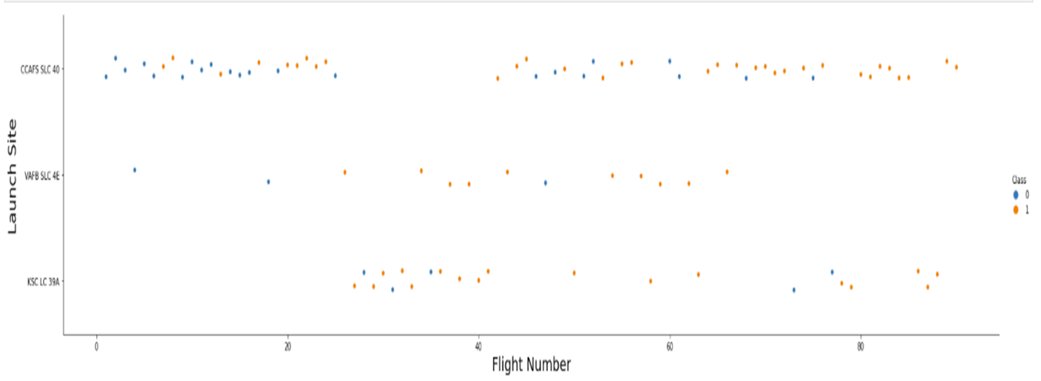
Flight Number vs. Launch Site
The more amount of flights at a launch site the greater the success rate at a launch site.

Slide 19
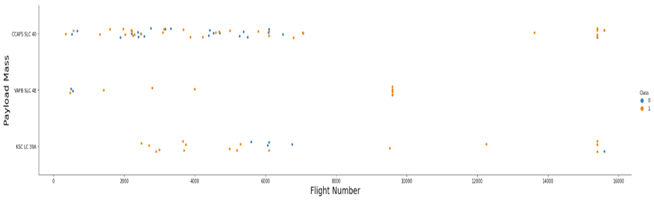
Payload vs. Launch Site
The greater the payload mass for Launch Site CCAFS SLC 40 the higher the success rate for the Rocket. There is not quite a clear pattern to be found using this visualization to make a decision if the Launch Site is dependant on Pay Load Mass for a success launch.

Slide 20
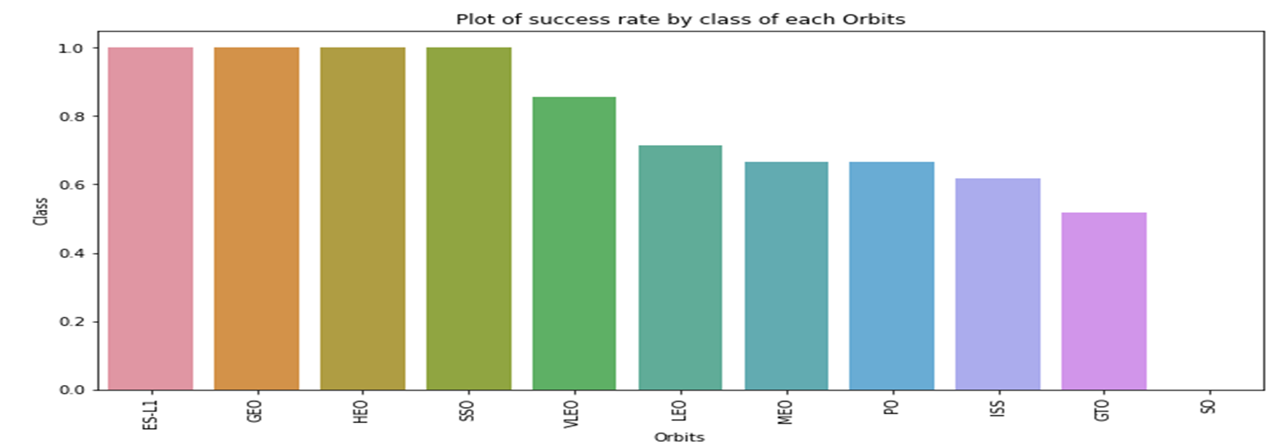
Success Rate vs. Orbit Type
Orbit ES-L1 , GEO, HEO, SSO has the best Success Rate

Slide 21
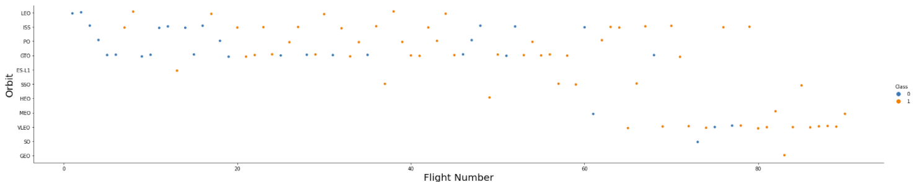
Flight Number vs. Orbit Type
You should see that in the LEO orbit the Success appears related to the number of flights; on the other hand, there seems to be no relationship between flight number when in GTO orbit.

Slide 22
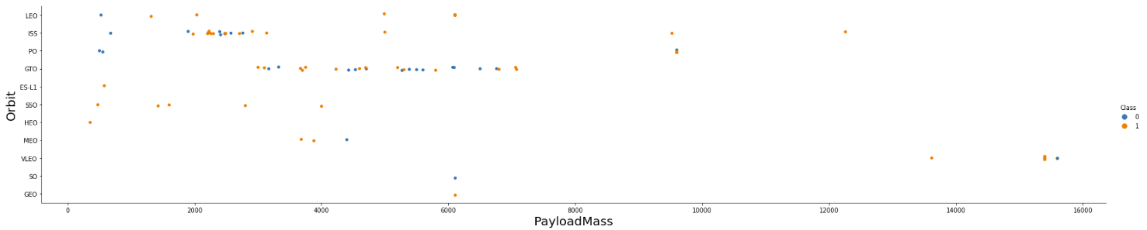
Payload vs. Orbit Type
You should observe that Heavy payloads have a negative influence on GTO orbits and positive on GTO and Polar LEO (ISS) orbits

Slide 23
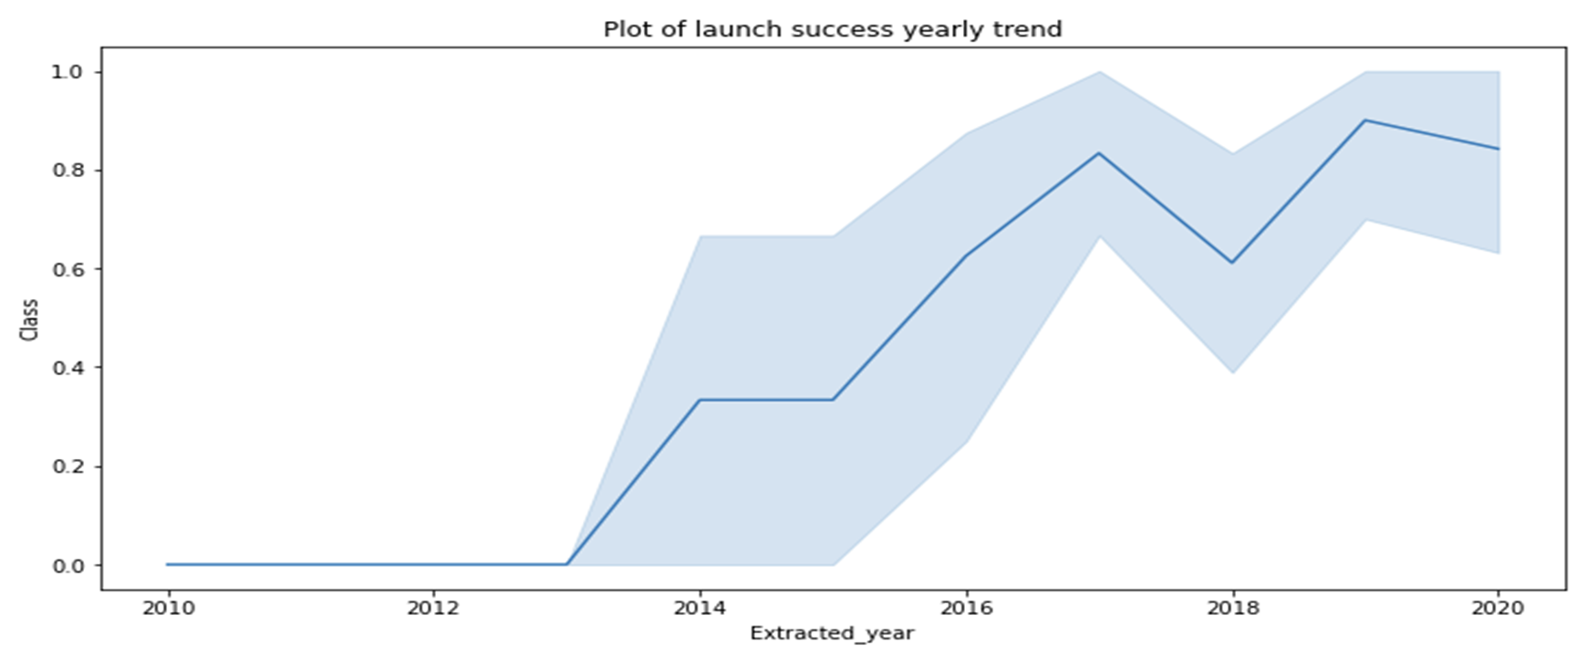
Launch Success Yearly Trend
The success rate since 2013 has kept increasing till 2020

Slide 24
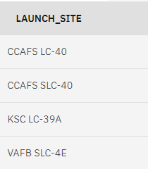
All Launch Site Names
The names of the unique launch sites using the key word DISTINCT to show only unique launch sites from the SpaceX data
SELECT DISTINCT launch_site FROM SPACEXTBL;

Slide 25
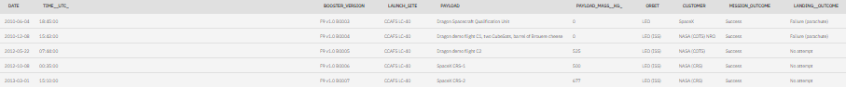
Launch Site Names Begin with 'CCA'
First we want to return all columns from the raw data. We then identify only the launch site that starts with “CCA” followed by wildcard characters. We have only returned the 5 records.
SELECT * FROM SPACEXTBL
WHERE launch_site LIKE 'CCA%'
limit 5;

Slide 26
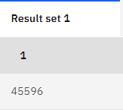
Total Payload Mass
The SUM function is used to add all of the payloads together. The WHERE clause only includes NASA customers
SELECT SUM(PAYLOAD_MASS__KG_) FROM SPACEXTBL
WHERE CUSTOMER = 'NASA (CRS)';

Slide 27
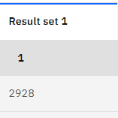
Average Payload Mass by F9 v1.1
The AVG function is used to calculate the average of the payloads. The WHERE clause only includes F9 v1.1 boosters
SELECT AVG(PAYLOAD_MASS__KG_) FROM SPACEXTBL
WHERE BOOSTER_VERSION = 'F9 v1.1';

Slide 28
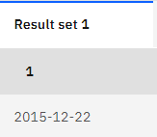
First Successful Ground Landing Date
The MIN function is used to call out the earliest date. The WHERE clause only includes Successful ground pad landings
SELECT MIN(DATE) FROM SPACEXTBL
WHERE LANDING__OUTCOME = 'Success (ground pad)';

Slide 29
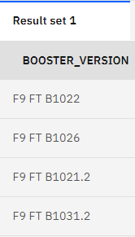
Successful Drone Ship Landing with Payload between 4000 and 6000
Returning only booster versions. WHERE clause is used to only return Successful landings on the drone ship AND payload mass is greater than 4000 but less than 6000
SELECT BOOSTER_VERSION FROM SPACEXTBL
WHERE LANDING__OUTCOME = 'Success (drone ship)'
AND (PAYLOAD_MASS__KG_ BETWEEN 4000 AND 6000);

Slide 30
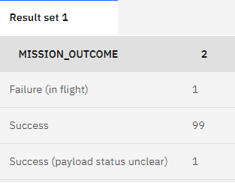
Total Number of Successful and Failure Mission Outcomes
100 successful and 1 failed mission
Using the GROUPBY function allows us to create categories of mission outcomes We can then use the COUNT function for each occurrence of that mission outcome
SELECT MISSION_OUTCOME, COUNT(*) FROM SPACEXTBL
GROUP BY MISSION_OUTCOME;

Slide 31
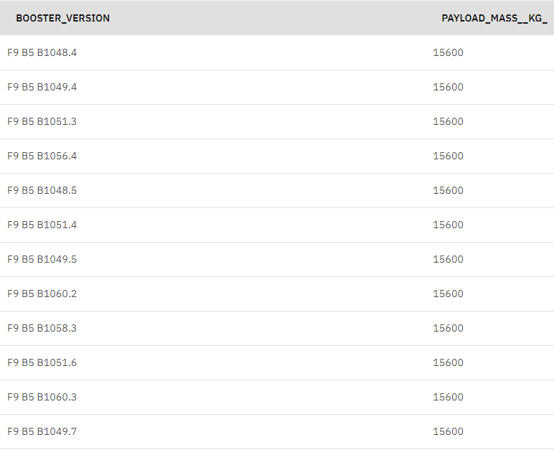
Boosters Carried Maximum Payload
We determined the booster that have carried the maximum payload using a subquery in the WHERE clause and the MAX() function
SELECT BOOSTER_VERSION, PAYLOAD_MASS__KG_ FROM SPACEXTBL
WHERE PAYLOAD_MASS__KG_ = (SELECT MAX(PAYLOAD_MASS__KG_) FROM SPACEXTBL);

Slide 32
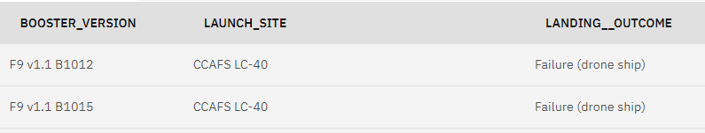
2015 Launch Records
There were only 2 records of failed landing on drone ship in the year 2015
We identified the 3 columns we wanted to return in the output. A WHERE clause with AND statement to ensure that only failed drone ship landings and dates starting in year 2015 are returned
SELECT BOOSTER_VERSION, LAUNCH_SITE, LANDING__OUTCOME FROM SPACEXTBL
where (LANDING__OUTCOME like 'Failure (drone ship)')
and (DATE like '2015%');

Slide 33
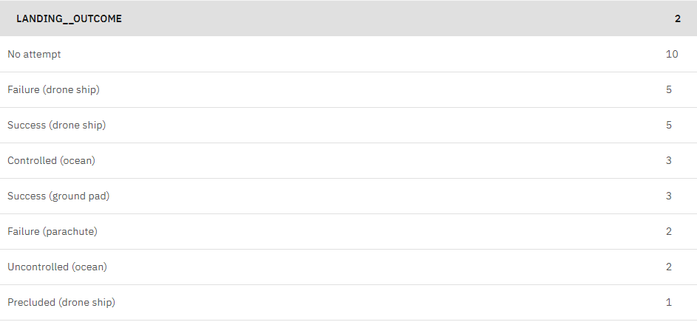
We only wanted to return landing outcome and the COUNT of each landing outcome. The WHERE clause to filter for landing outcomes BETWEEN given dates. GROUP BY clause for each landing outcome and ORDER BY clause to have the final output in descending order
SELECT LANDING__OUTCOME, COUNT(LANDING__OUTCOME) FROM SPACEXTBL
WHERE DATE BETWEEN '2010-06-04' AND '2017-03-20'
GROUP BY LANDING__OUTCOME
ORDER BY COUNT(LANDING__OUTCOME) DESC;
Rank Landing Outcomes Between 2010-06-04 and 2017-03-20

Slide 34

Section 3

Slide 35
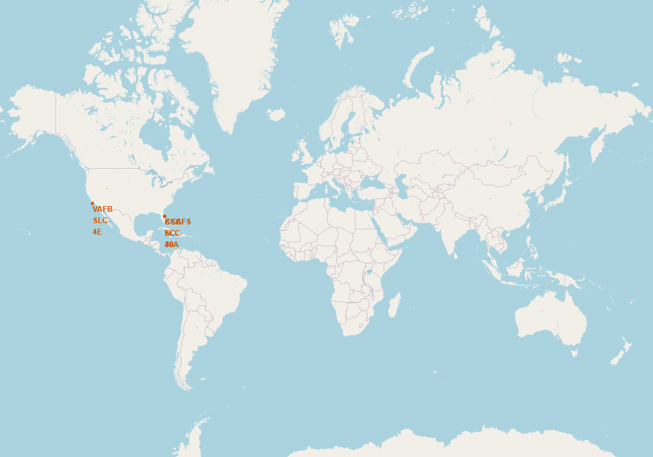
All Launch Sites Global map markers
We can see that the SpaceX launch sites are in the United States of America coasts. Florida and California

Slide 36
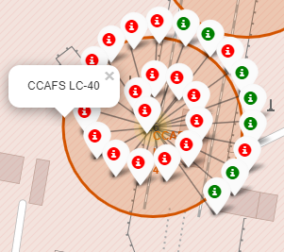
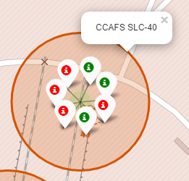
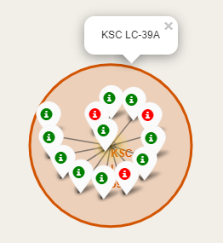
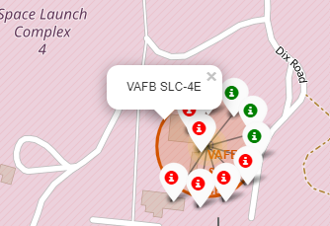
Markers showing launch sites with color labels
Florida Launch Site
California Launch Site
Green markers shows successful launch sites red markers shows failures

Slide 37
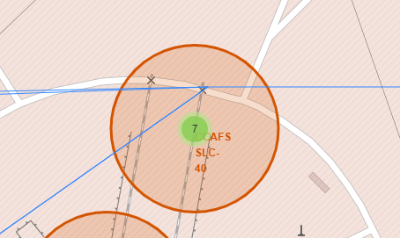
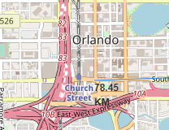
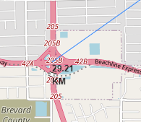
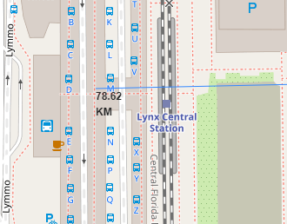
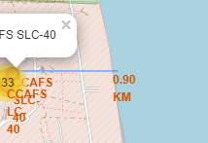
Launch Site distance to landmarks using CCAFS-SLC-40 as a reference
Starting launch site
Distance to City
Distance to Highway
Distance to Railway
Distance to Coastline
Are launch sites in close proximity to railways? No
Are launch sites in close proximity to highways? No
Are launch sites in close proximity to coastline? Yes
Do launch sites keep certain distance away from cities? Yes

Slide 38

Section 4

Slide 39
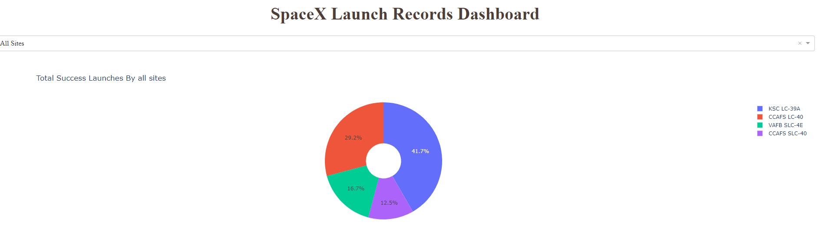
Dashboard – launch success rates across all sites
We can see that KSC LC-39A had the most successful launches from all the sites

Slide 40
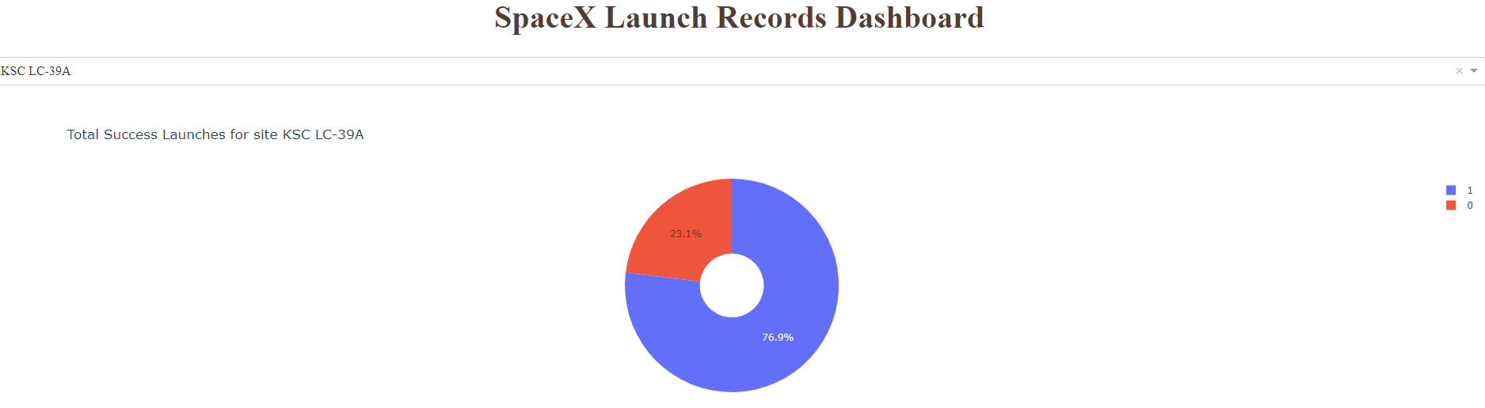
Dashboard –the launch site with highest launch success ratio
KSC LC-39A achieved a 76.9% success rate while getting a 23.1% failure rate

Slide 41
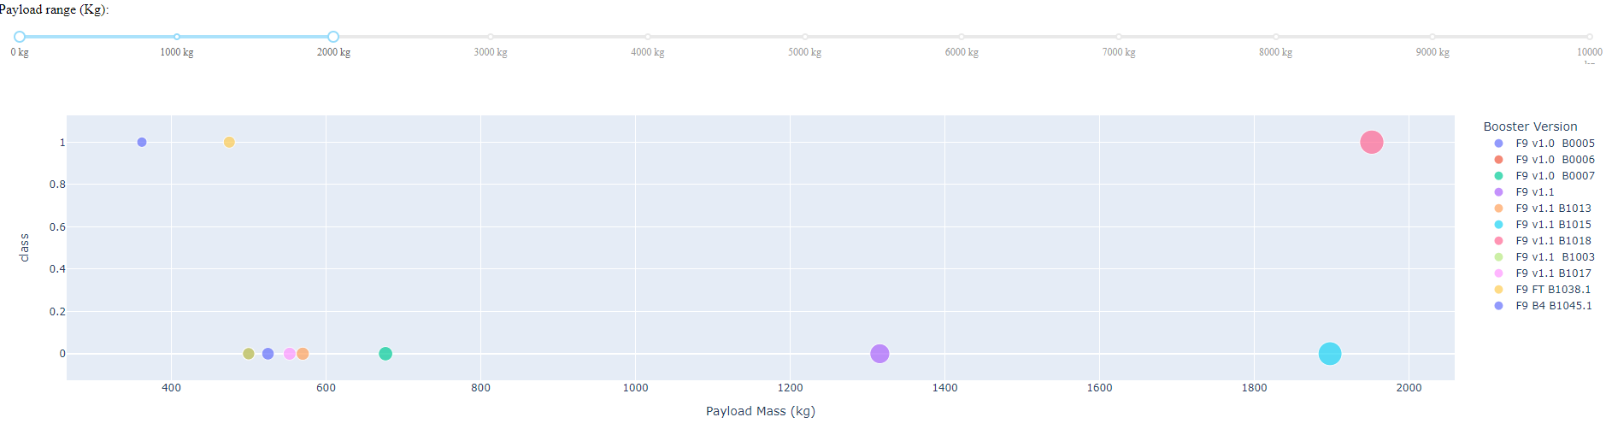
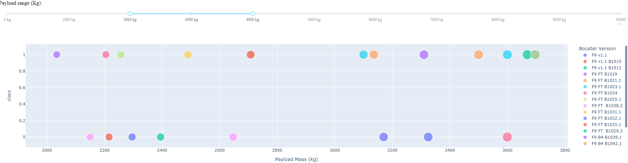
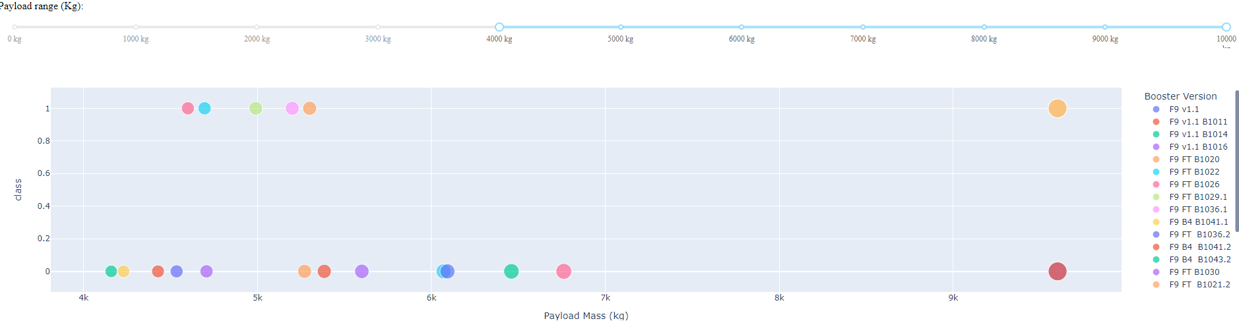
Dashboard – Payload vs. Launch Outcome scatter plot for all sites, with different payloads
Light weight
Medium weight
Heavy weight
We can see the success rates for payloads between 2000kg and 4000kg have a higher success rate

Slide 42

Section 5

Slide 43
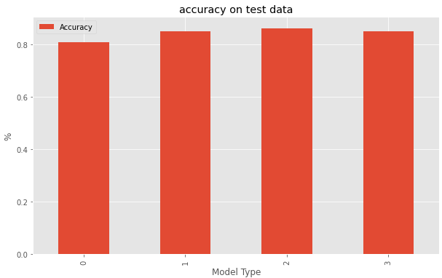
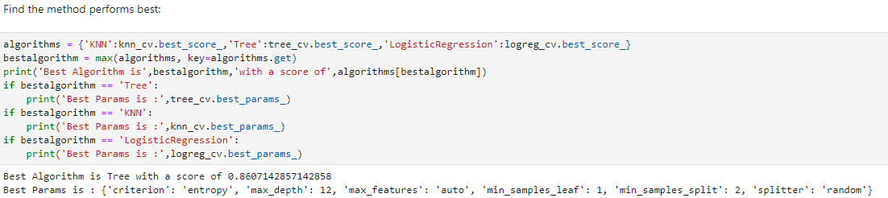
Classification Accuracy
0 = Logistic Regression 1 = Support Vector Machine
2 = Decision Tree 3 = K-Nearest Neighbour
The Decision Tree algorithm provides the best score of 86.1% after tuning the parameters for each

Slide 44
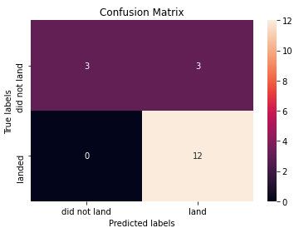
Confusion Matrix
The confusion matrix for the decision tree classifier shows that the classifier can distinguish between the different classes. The major problem is the false positives .i.e., unsuccessful landing marked as successful landing by the classifier.

Slide 45
Conclusions
The Decision Tree Classifier Algorithm is the best for Machine Learning for this dataset
We can see that KSC LC-39A had the most successful launches from all the sites
Orbit GEO,HEO,SSO,ES-L1 has the best Success Rate
Payloads between 2000kg and 4000kg have a higher success rate
SpaceX launch success rate started to increase year on year from 2013 through to 2020

Slide 46


